Slide 1
OMIS 661 Wide World Importers Analysis
Team 10
Anusha Kokkinti | Bharath Nanduri

Slide 2
Introduction
Wide World Importers are into wholesale
Present throughout the US
Planning for Expansion

Slide 3
Analysis
Suitable geography for expansion
Optimizing Operations & Process Improvement
Exploring revenue growth opportunities

Slide 4
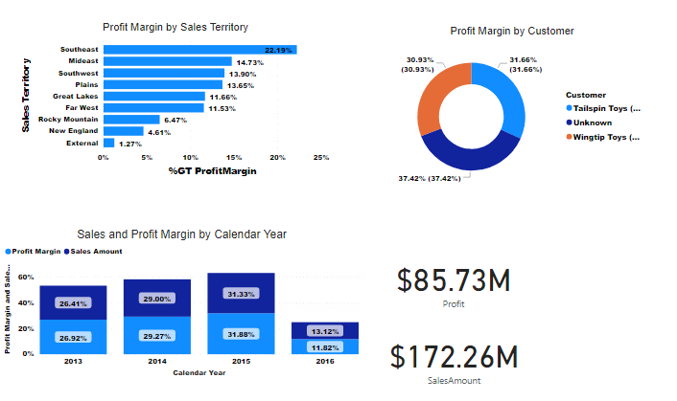
PI Dashboards – Profit Margin Analysis

Slide 5
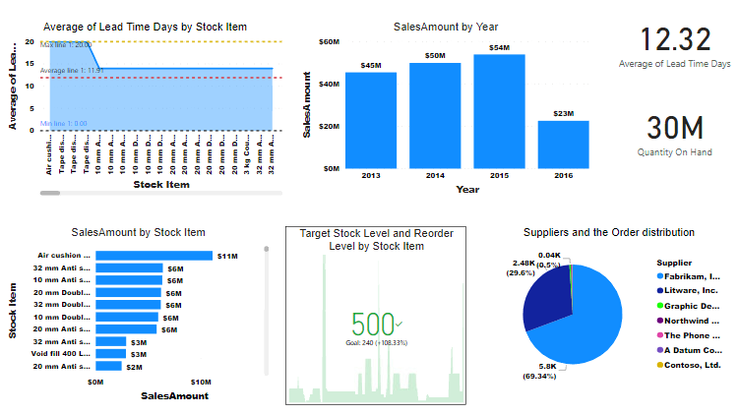
PI Dashboards – Lead Time Analysis

Slide 6
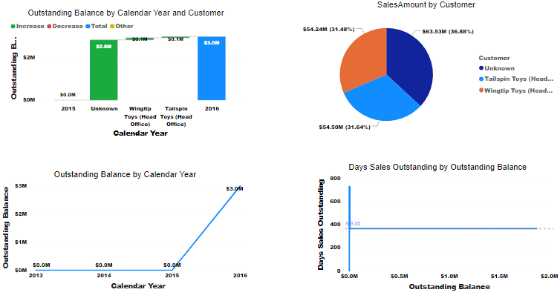
PI Dashboards – Outstanding Analysis

Slide 7
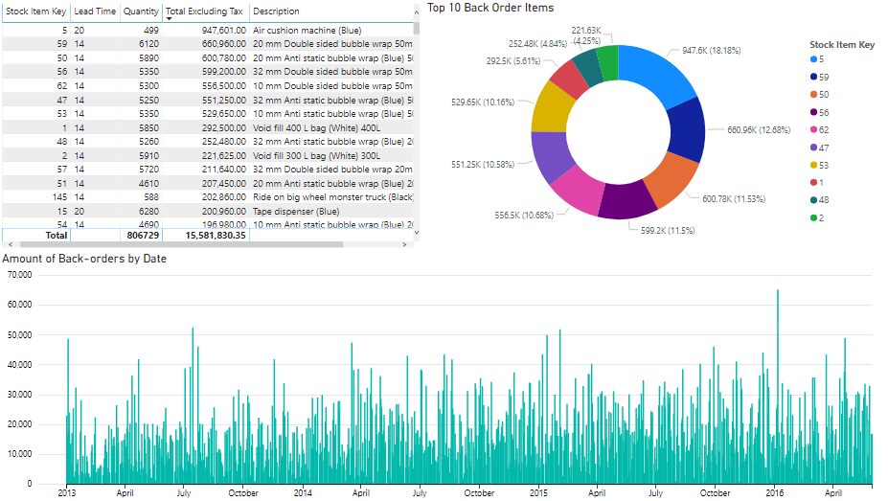
Dashboards – PI – Backorder Analysis

Slide 8
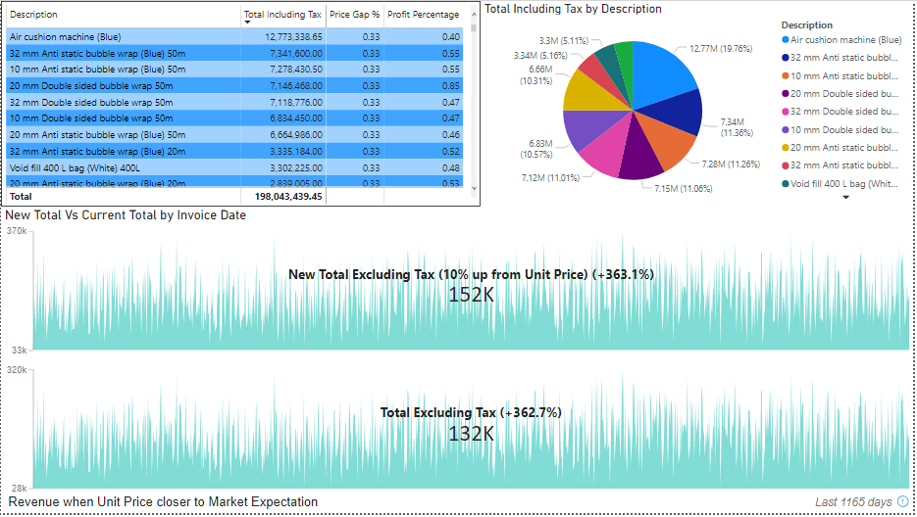
Dashboards – Revenue Generation

Slide 9
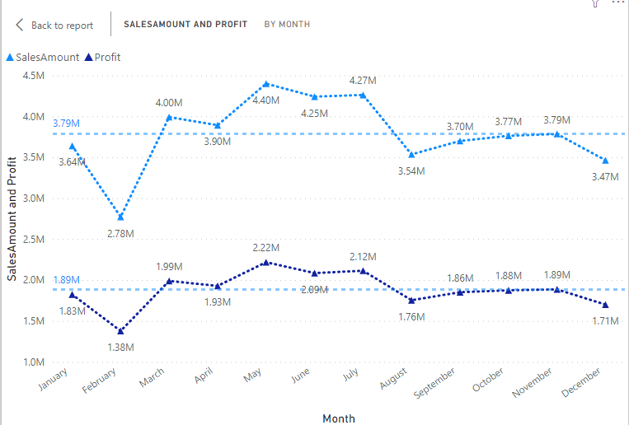
Data Patterns – Trend Analysis
2013

Slide 10
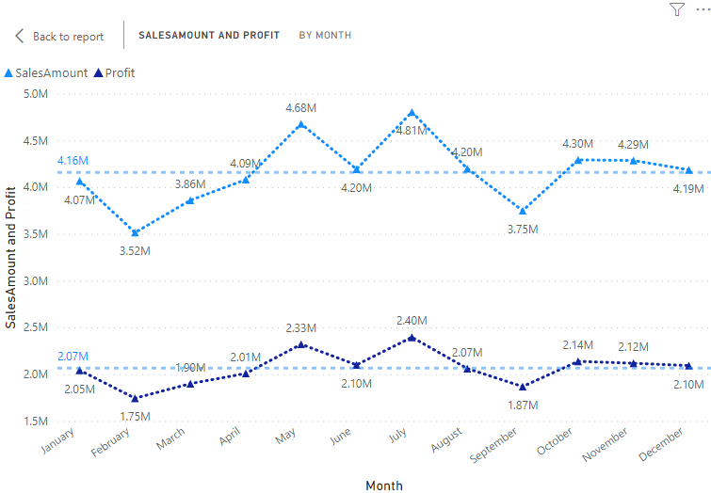
Data Patterns – Trend Analysis
2014

Slide 11
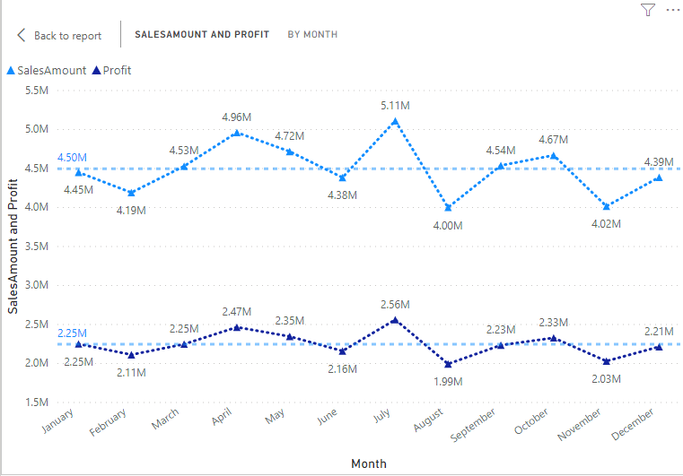
Data Patterns – Trend Analysis
2015

Slide 12
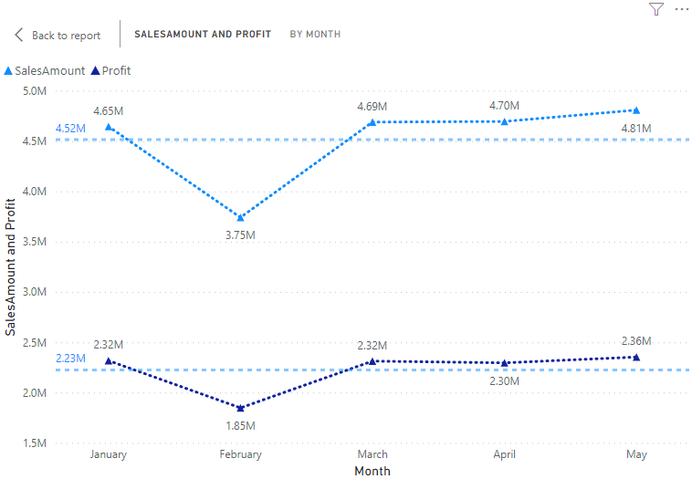
Data Patterns – Trend Analysis
2016

Slide 13
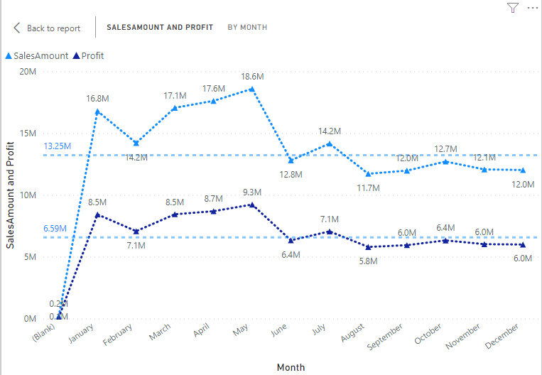
Data Patterns – Trend Analysis
Overall

Slide 14
Data Patterns – Trend Analysis
Observations
Busy period with maximum sales - Summer
Low sales period – Post Christmas, New Year
Utilize to optimize inventory

Slide 15
Recommendations
Reduce the inventory holding costs
South - East is most favorable for expansion
Source from more reputed suppliers with good service levels
Implement a solid Information System

Slide 16
Recommendations
Increase base price based on demand and price gap
Align the processes to sell more of high profit products and
Implement better Analytical capabilities
Scrap and remodel based on item movement

